Slide 1
DREAM AND SLEEP ANALYSIS
OF AN INDIVIDUAL
Project Dissertation
SNEHA MUKHERJEE
ROLL -STI202015
REGISTRATION No.-1348 of 2020-21

Slide 2

INTRODUCTION
Dream analysis is an interesting method for knowing our mental and emotional health. We can interpret our dreams by analytical method.
A sleep analysis is a technique to record the activity of the body while sleeping and from there to find if the sleep quality is good or not.

Slide 3
OBJECTIVE
The aim of this analysis is to test if I can predict the number of dreams which one person will recall , how happy those dreams will be and how his sleep quality is.

Slide 4
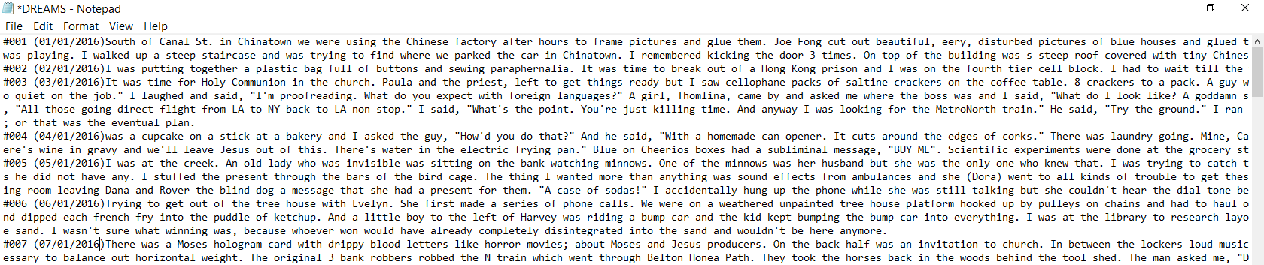
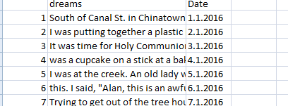
DREAM ANALYSIS
● Aim : I have to show how dream recall varies by weekdays and what emotions my dreams are made up of.
● Dataset : To show this I have taken the dataset into a csv file from that text file. I have found it from
https://github.com/mpriestley/dream-analysis/blob/master/merri_dreams.txt

Slide 5
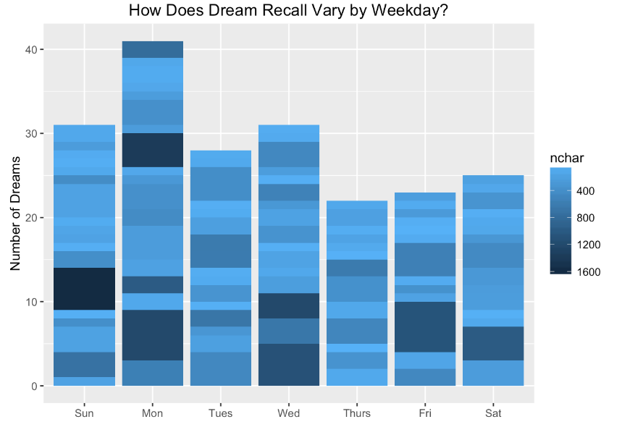
VISUALIZATION

Slide 6
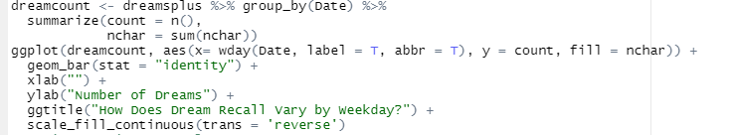
R - CODE

Slide 7
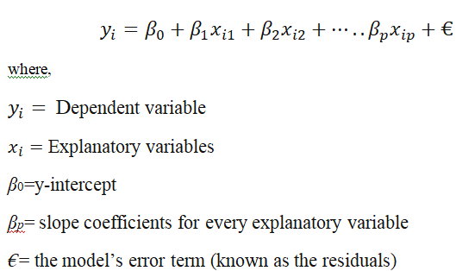
PREDICTIONS
How many dreams I will remember :
Multiple linear regression–
Formula and Calculation of Multiple Linear Regression :

Slide 8
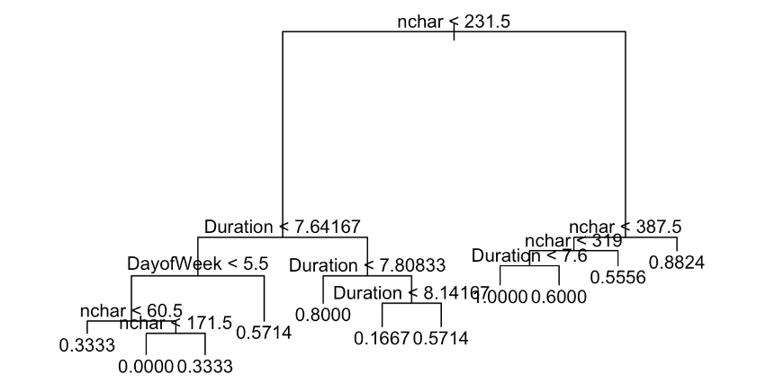
PREDICTIONS
Whether I have a good dream or not:
Decision tree-

Slide 9

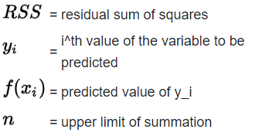
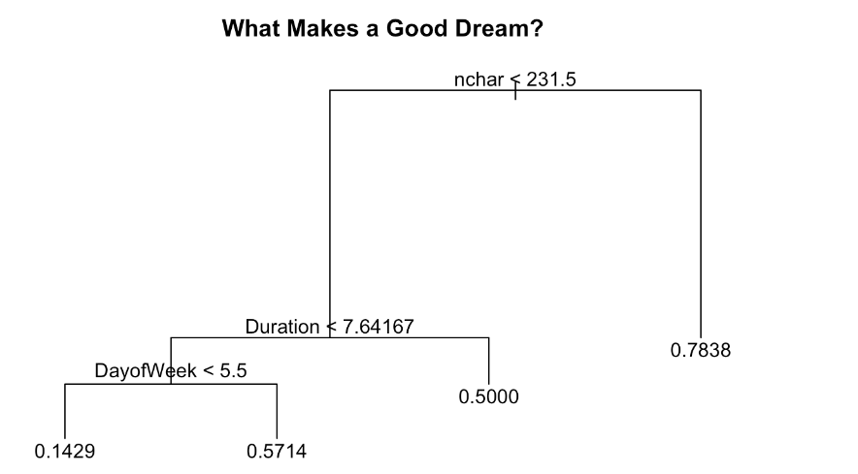
RSS-

Slide 10
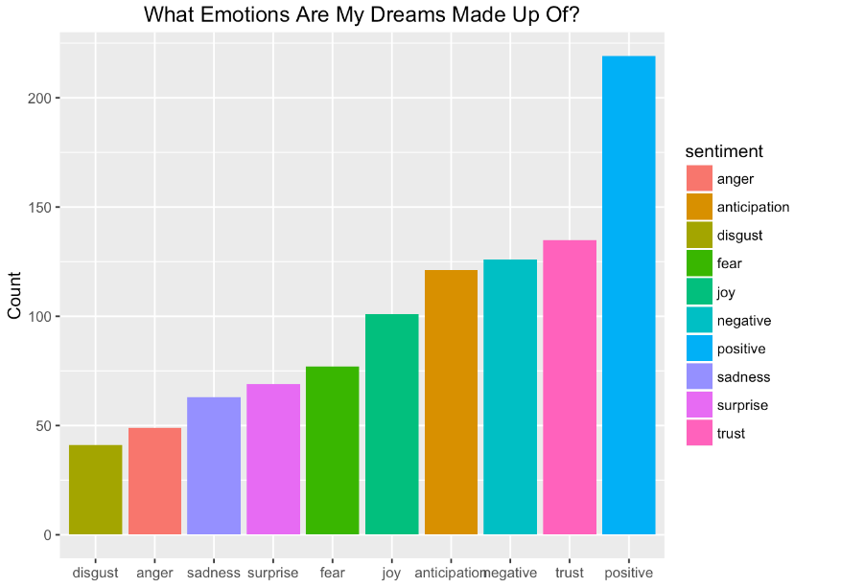
FINDING EMOTIONS
Sentiment analysis in R :

Slide 11
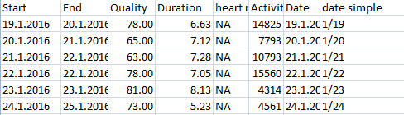
SLEEP ANALYSIS
● Aim : If his sleep is proper or not, how much time he sleep at night and wake up in the morning— from this analysis, we can find all the details.
● Dataset : To show this I have taken the dataset into as csv file format. I have got this dataset from
https://www.kaggle.com/dataset/danagerous/sleep-data?resource=download

Slide 12
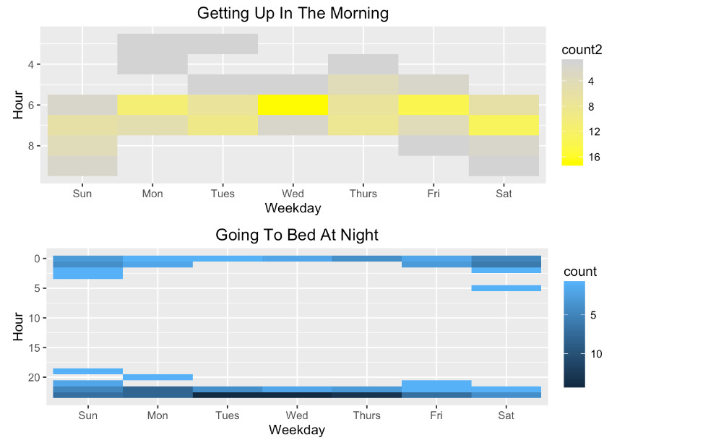
VISUALIZATION

Slide 13
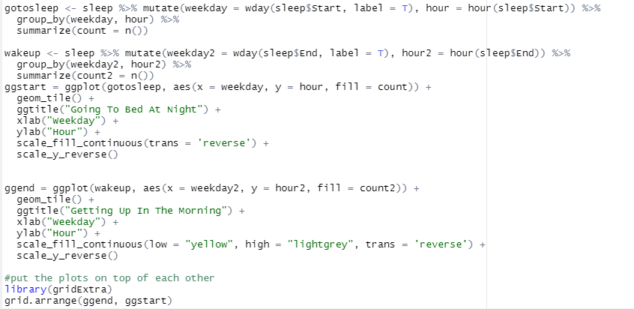
R - CODE

Slide 14
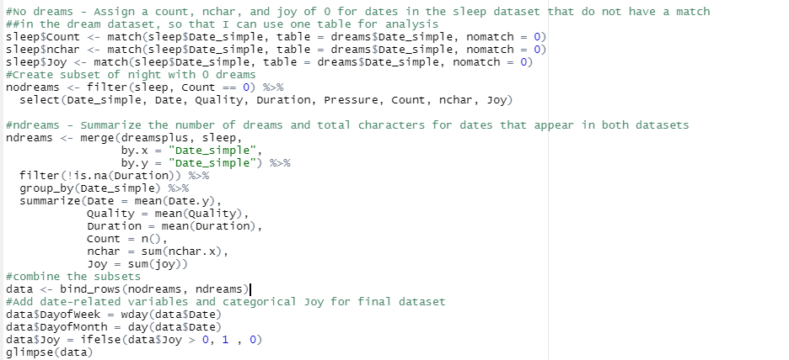
FINDINGS AFTER MERGING SLEEP AND DREAM DATASET
Correlation Matrix:
R code –

Slide 15
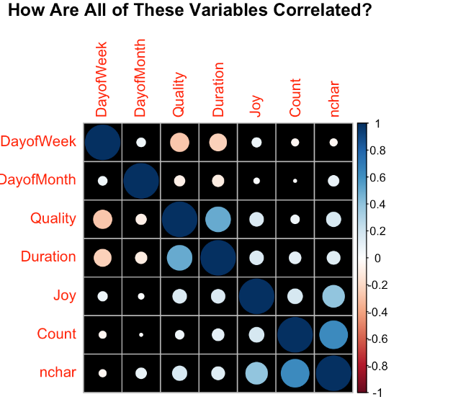
VISUALIZATION

Slide 16
DISCUSSION AND FUTURE WORK
From this project, I could be able to find the emotions included in his dreams and can say how his sleep quality is and how dream and sleep are correlated among each other.
In future I will gather more datasets for different persons. Then I will find the comparison between their dreams . I will also find out if gender differences are necessary for dream interpretation or not.

Slide 17
ACKNOWLEDGEMENT
It has been a great opportunity to gain lots of experience in Logistic Regression followed by machine learning. We would like to express our special thanks to our project supervisor Sir Hare Krishna Maity who gave us the golden opportunity to do this wonderful project.

Slide 18
REFERENCE
Cohen, J. (1988). Statistical power analysis for the behavioral sciences. Hillsdale: Lawrence Erlbaum
Hall, C. S., & Van de Castle, R. L. (1966). The content analysis of dreams. New York: Appleton-Century-Crofts
Roussy, F., Brunette, M., Merrier, P., Gonthier, I., Grenier, J., Sirois-Berliss, M., Lortie-Lussier, M., & De Koninck, J. (2000). Daily events and dream content: unsuccessful matching attempts. Dreaming, 10, 77-83
Zane, M. D. (1971). Significance of differing responses among psychoanalysts to the same dream. In J. H. Masserman (Ed.), Dream dynamics (pp. 174-177). New York: Grune & Stratton.Zane, M. D. (1971).
Significance of differing responses among psychoanalysts to the same dream. In J. H. Masserman (Ed.), Dream dynamics (pp. 174-177). New York: Grune & Stratton

